Slide 1

Tatyasaheb Kore Institute of Engineering and Technology, Warananagar.
USED VEHICLE PRICE PREDICTION SYSTEM
Presented by
Guided by
Name Roll No
1. Omkar J. Raut 264
2. Aditya S. Waghmare 269
3. Jayash P. Kolekar 271
4. Siddik R. Mullani 278
Prof. S. M. Ranbhise
Mini Project synopsis presentation on
Used Vehicle Price Prediction System
Submitted by
Group id : C4-G4
Computer Science and technology
2022-23

Slide 2
Content
Introduction
Existing System
Problem Statement
Objective
Functional Requirements
Non Functional Requirements
Proposed System
Module
Design
Use Case Diagram
Hardware and software requirements
Conclusion
Reference
2022-23
2

Slide 3
Used Vehicle Price Prediction System
2022-23
3

Slide 4
1. Introduction
We see in our day-to-day life, it’s hard to predict the price of a used vehicle. So, to facilitate the price prediction of used vehicles, we implement the idea of an automatic system for the price prediction of used vehicles. The main technology will use machine learning concepts through the python programming language.
Used Vehicle Price Prediction System
2022-23 3

Slide 5
2.Existing System
The existing system of used vehicle price determination can vary depending on the region and market. In many cases, the current approach involves manual valuation by individuals based on limited information.
Individuals with experience in the automotive industry, such as car dealers, use their knowledge and expertise to estimate the value of a used vehicle. They consider factors like the vehicle's make, model, age, mileage, condition, and market demand.
Used Vehicle Price Prediction System
2022-23
4

Slide 6
3. Problem Statement
If anyone wants to sell their vehicle either they have to take their vehicle to a respective company workshop or have to make an appointment for the company to get an estimate of the price. This process involves a lot of time and resources. Our Objective is to make a model for customer that will make an estimate of the Price of the customer’s vehicle directly.
Used Vehicle Price Prediction System
2022-23
5

Slide 7
4.Objective
The objective of application is to predict the price of used vehicles using machine learning models. There are some objectives about system:
To study about brands and types of the vehicle
To study model of the vehicle, year of manufacturing of vehicle, type of fuel, Ex-Showroom price
To study about machine learning concepts and processing data to predict things
Used Vehicle Price Prediction System
2022-23
6

Slide 8
5.Functional Requirements
Vehicle Information Input
Data Validation and Verification
Price Prediction Model
Price Estimation
Used Vehicle Price Prediction System
2022-23
7

Slide 9
6.Non Functional Requirement
Usability: The system should have a user-friendly interface that is intuitive and easy to navigate. The system should provide clear instructions and guidance to users during the input and prediction process.
Performance: The system should efficiently process and analyze data to provide accurate and timely price predictions.
Accuracy and Precision: The system should strive for high accuracy in price predictions, minimizing deviations from actual market prices.
Used Vehicle Price Prediction System
2022-23
8

Slide 10
7.Proposed System
The proposed system for used vehicle price prediction aims to enhance the accuracy, efficiency, and transparency of determining the value of a used vehicle.
The proposed system aims to predict the price of used vehicle by machine learning and user-friendly interfaces to provide more accurate, transparent, and reliable price predictions.
Used Vehicle Price Prediction System
2022-23
9

Slide 11
8.Modules
1. Vehicle Information Module:
This module captures and stores the details of the vehicle being evaluated, such as make, model, year, mileage, and other features.
2. Historical Data Module:
This module collects and maintains historical sales data, market trends, and price fluctuations of similar vehicles
3. Data Pre-processing Module:
This module pre-processes the input data to handle missing values, outliers, categorical variables, and data normalization.
4. Model Training and Validation Module:
This module trains the price prediction model using the available historical data, splitting it into training and validation sets
5. Machine Learning Module:
Trains and fine-tunes machine learning models based on historical crop performance data and location-specific factors
Used Vehicle Price Prediction System
2022-23
10

Slide 12
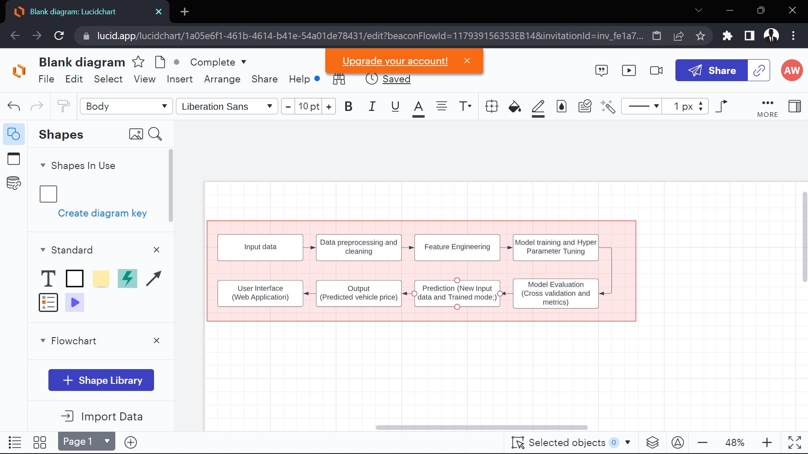
9.Design
Used Vehicle Price Prediction System
2022-23
13

Slide 13
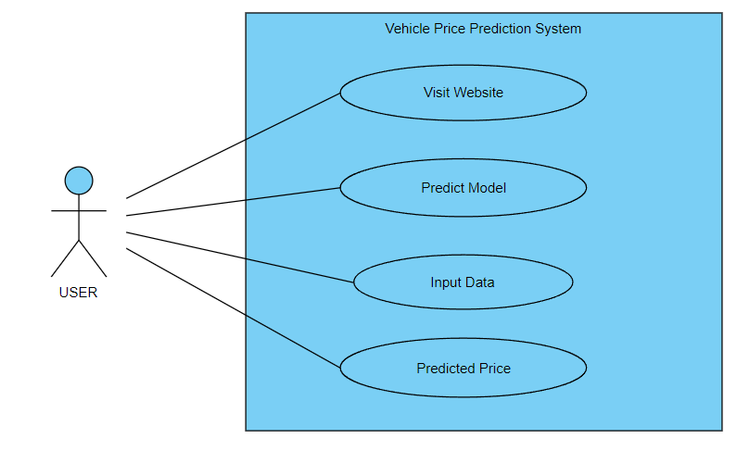
Use Case Diagram
Used Vehicle Price Prediction System
2022-23
12

Slide 14
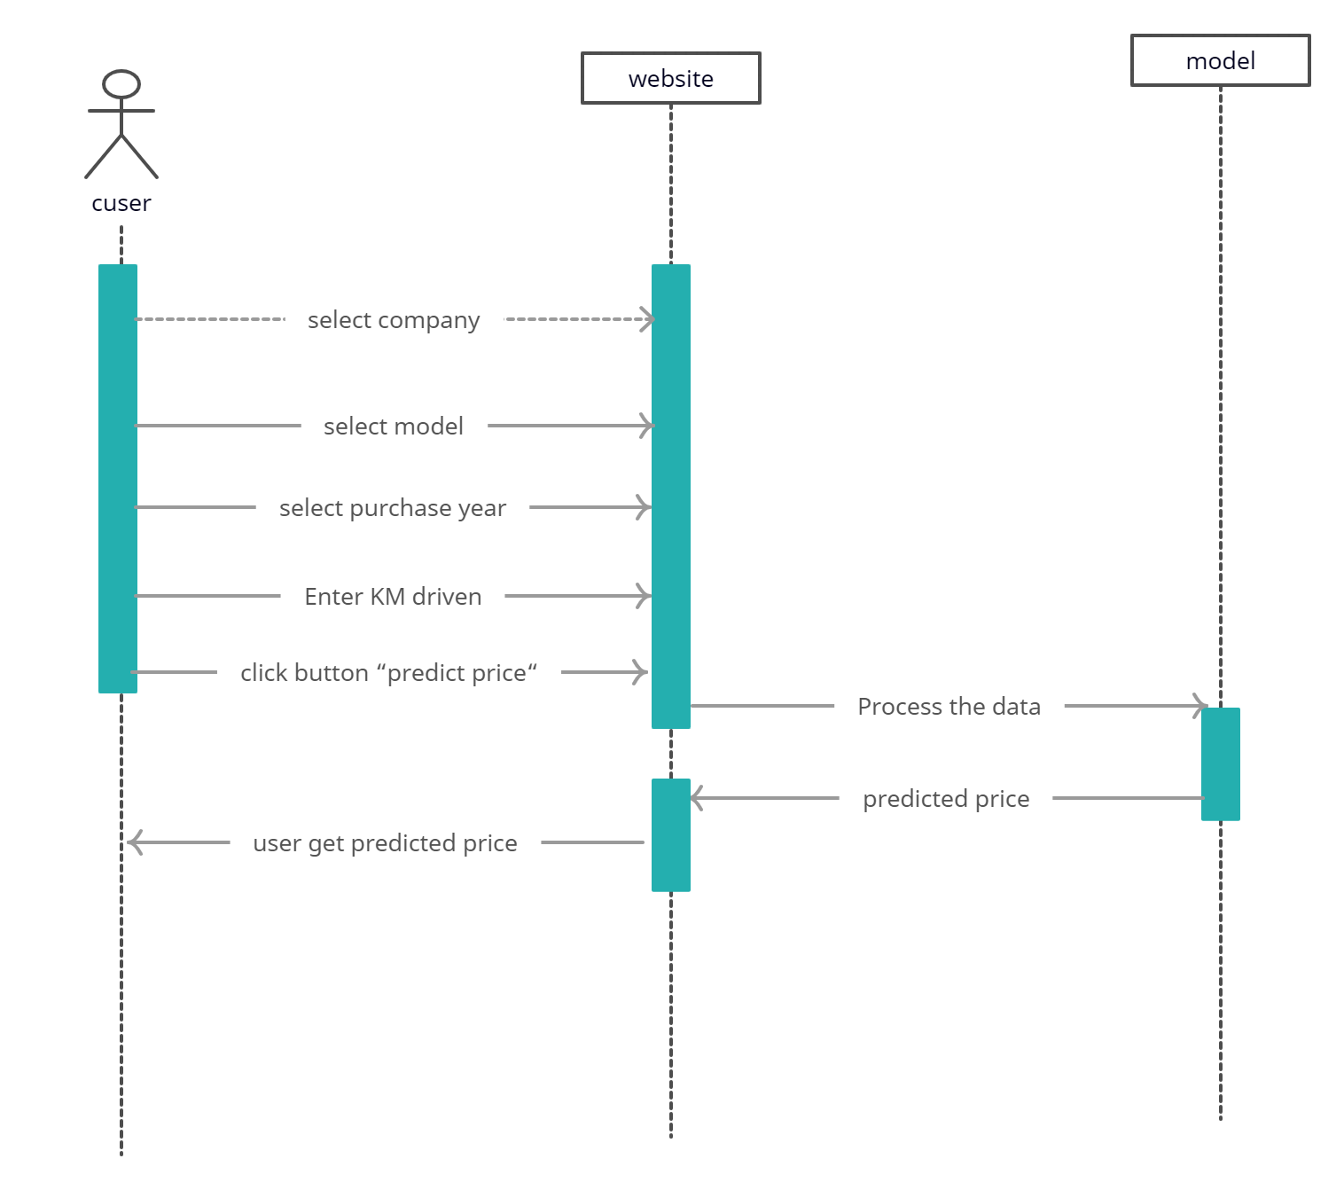
Sequence Diagram
Used Vehicle Price Prediction System
2022-23
12

Slide 15
10.Hardware and software requirements
Hardware tools:
System:- Ryzen-5 processor
Hard disk:- 512 Gigabytes
RAM :- 8 Gigabytes
Software Requirement:
Operating System:- Windows 11
Coding language:- Python, HTML, Cascading Style Sheet, JavaScript
Used Vehicle Price Prediction System
2022-23
15

Slide 16
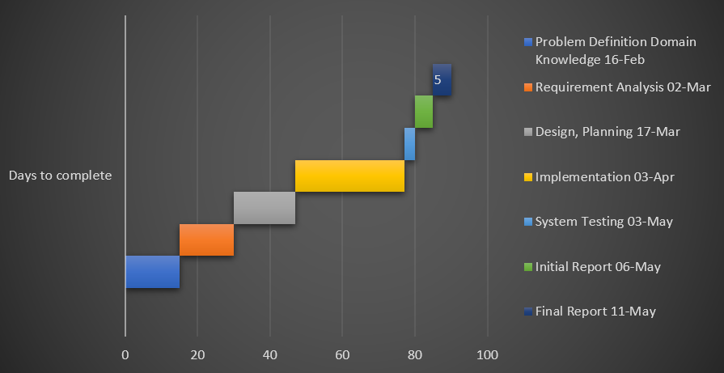
11.Gantt Chart
Used Vehicle Price Prediction System
2022-23
16

Slide 17
12.CONCLUSION
The development of a used vehicle price system brings numerous benefits to the automotive market. By using data-driven approaches, machine learning algorithms, and user-friendly interfaces, the system enhances the accuracy, efficiency, and transparency of determining the value of used vehicles.
Used Vehicle Price Prediction System

Slide 18
References
Gongqi, S., Yansong, W., & Qiang, Z. (2011, January). New Model for Residual Value Prediction of the Used vehicle Based on BP Neural Network and Nonlinear Curve Fit. In Measuring Technology and Mechatronics Automation (ICMTMA), 2011 Third International Conference on (Vol. 2, pp. 682-685). IEEE.
K. Samruddhi and R. Ashok Kumar, "Used vehicle Price Prediction using K-Nearest Neighbor Based Model", International Journal of Innovative Research in Applied Sciences and Engineering, vol. 4, no. 3, pp. 686-689, 2020.
Used Vehicle Price Prediction System
17

Slide 19
THANK YOU!

